Slide 1

ChatBot Using AWS LEX UB Ride Final Project
Sai Vignesh Kumar Reddy Alluri - 1136665

Slide 2
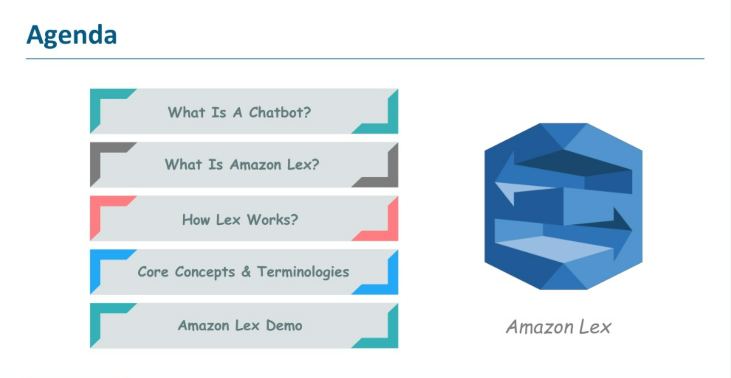

Slide 3
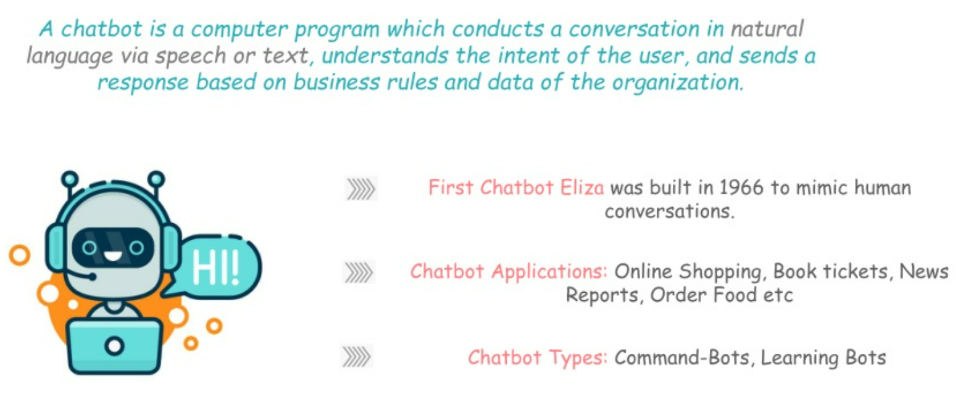
What is ChatBot ?

Slide 4
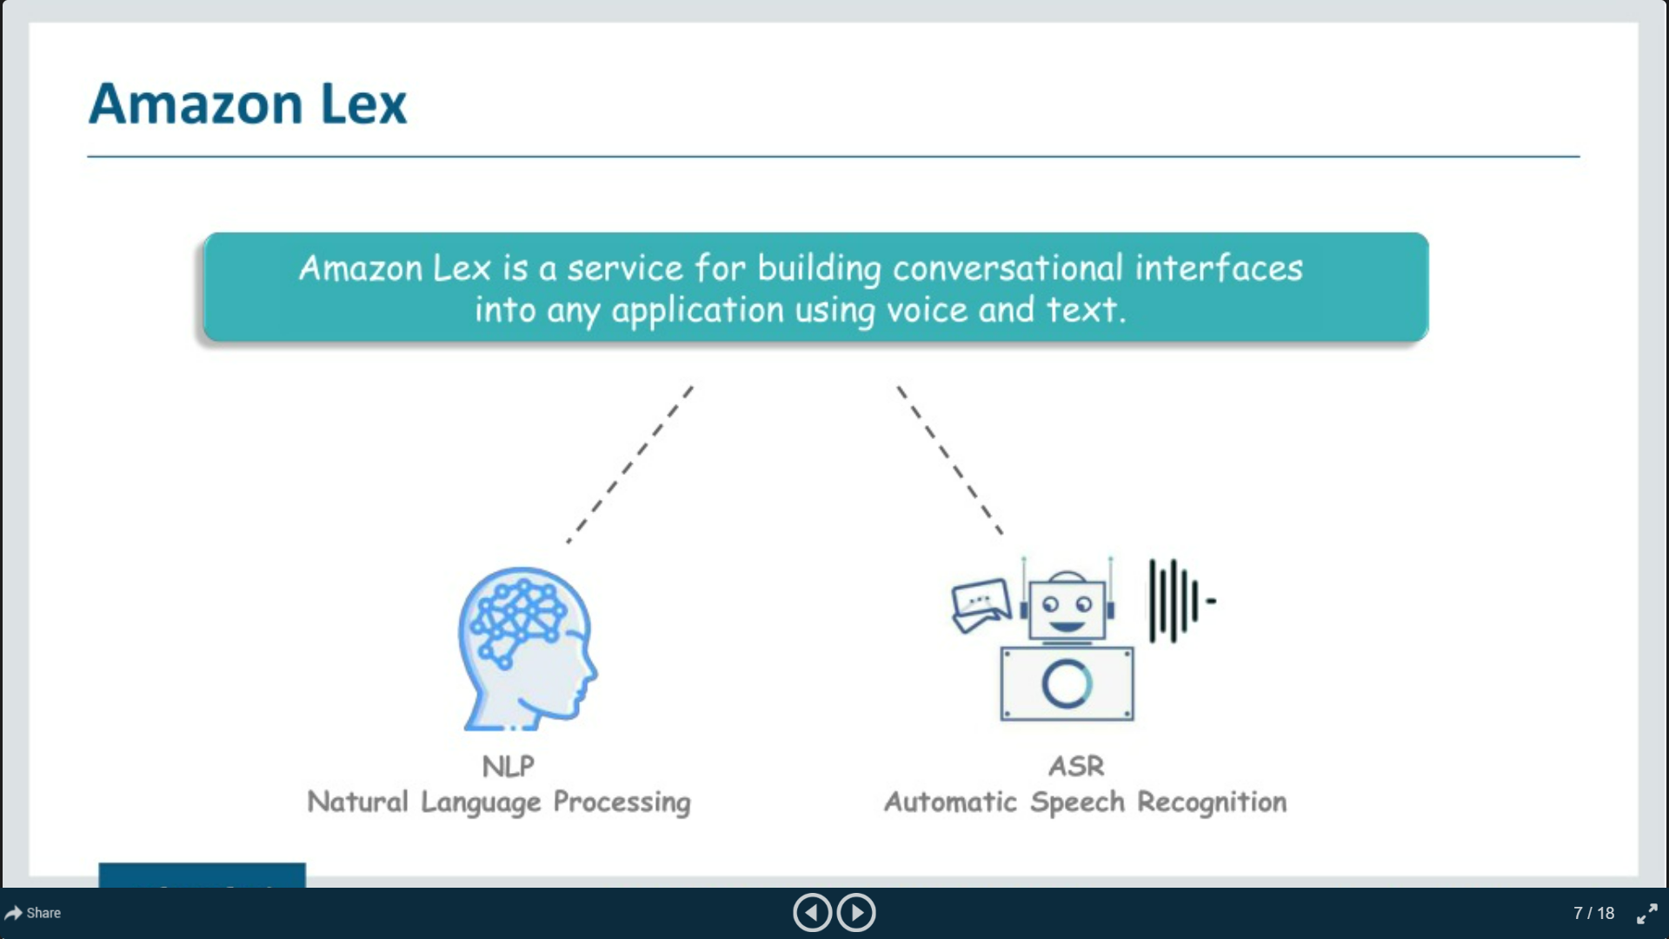
What is Amazon Lex ?

Slide 5
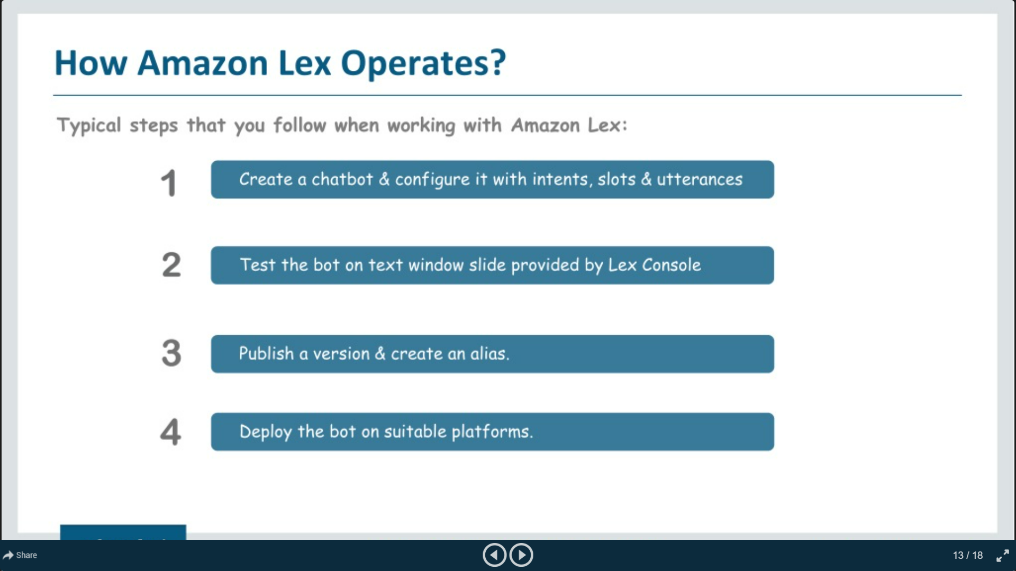
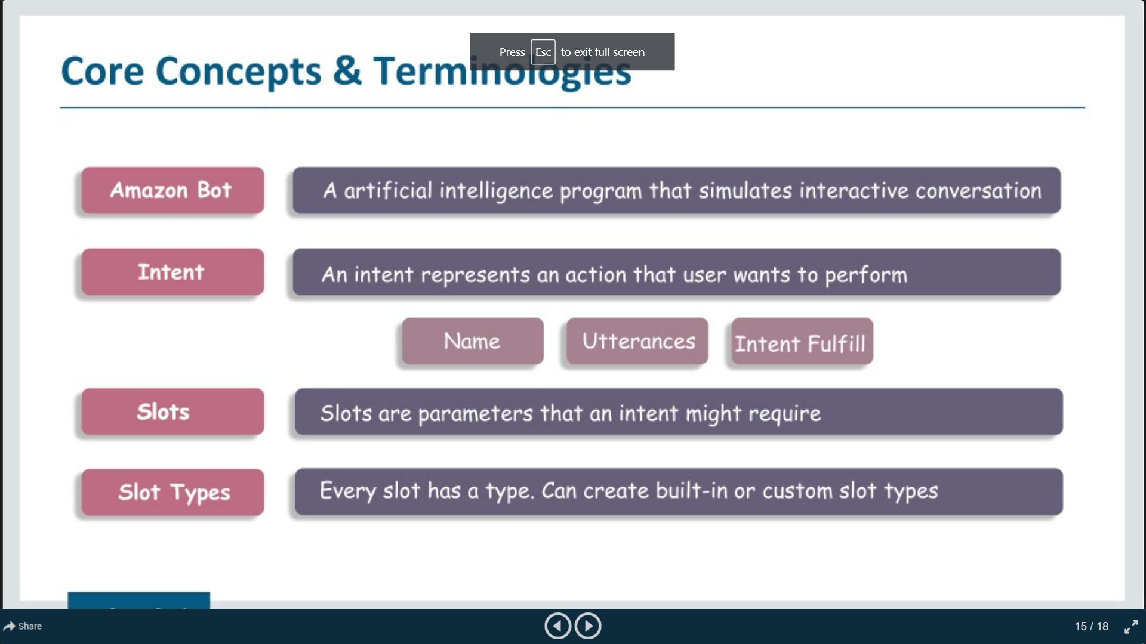
How Lex Operates?

Slide 6
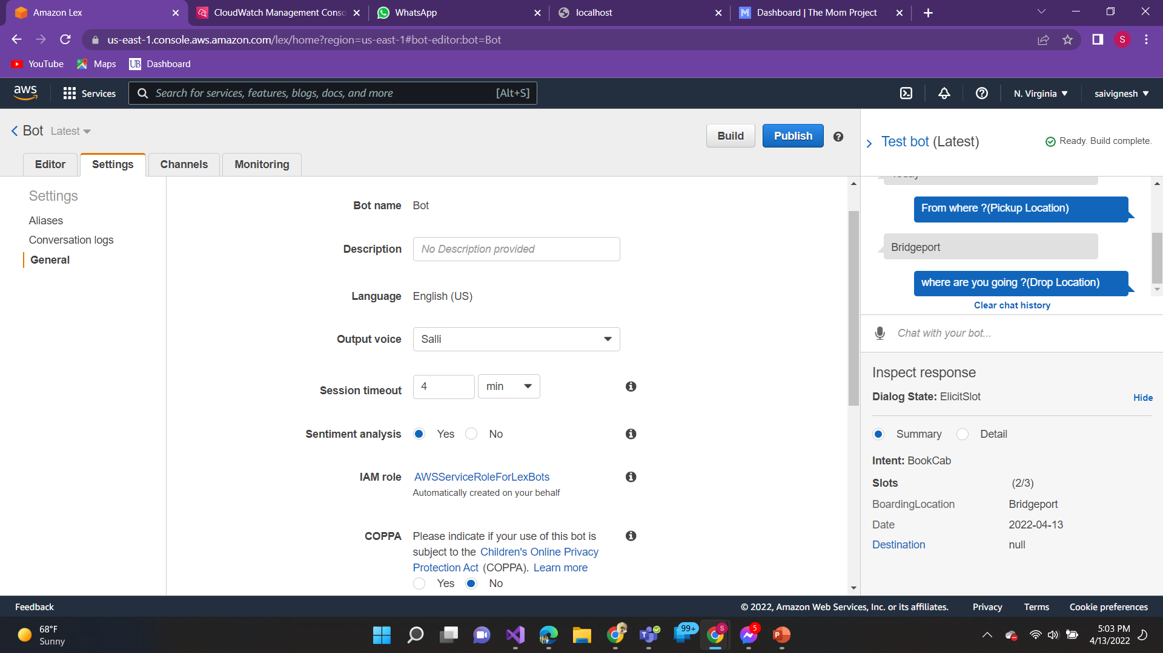
Creating a bot using LEX

Slide 7
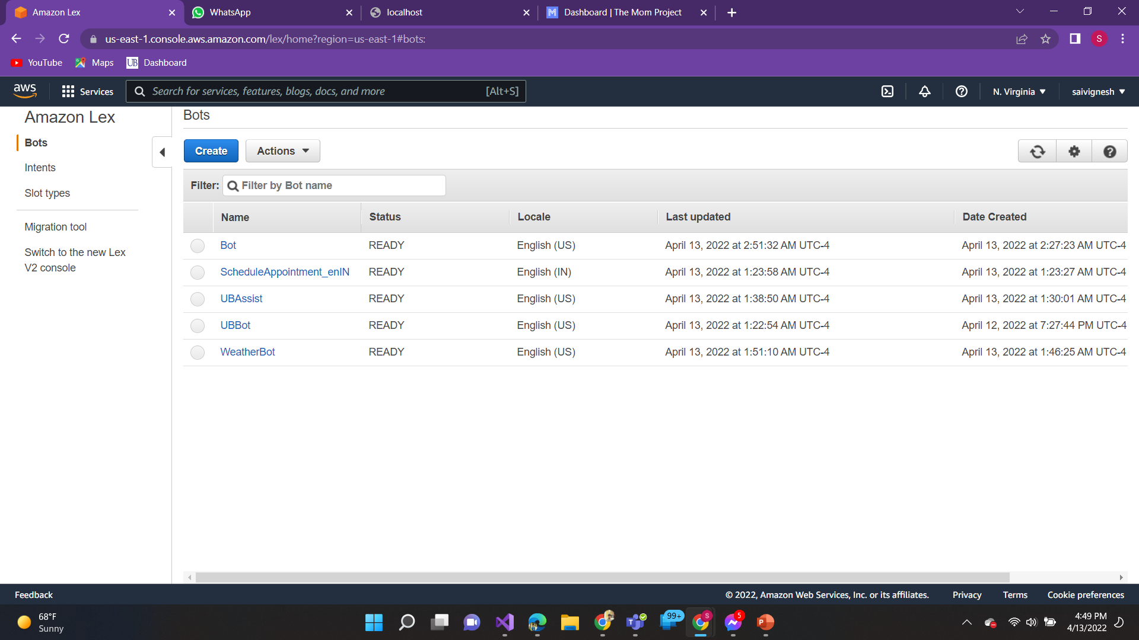
Created a ChatBot :

Slide 8
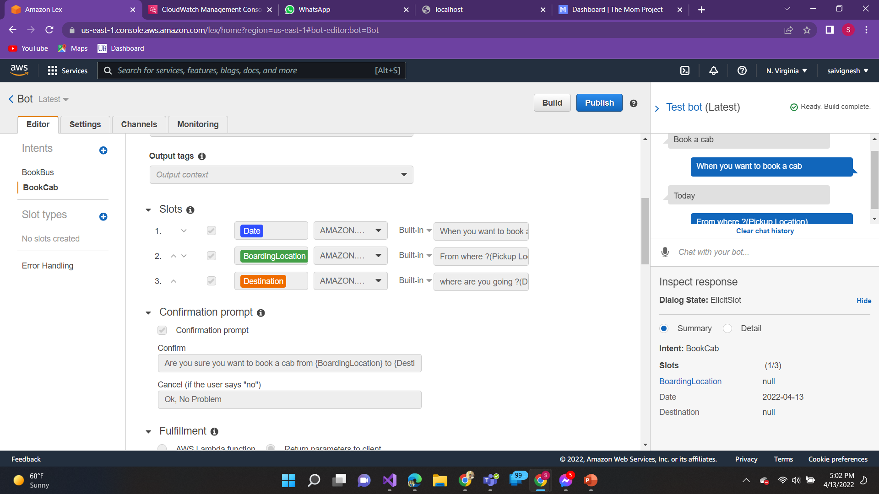
Creating an Intents:

Slide 9
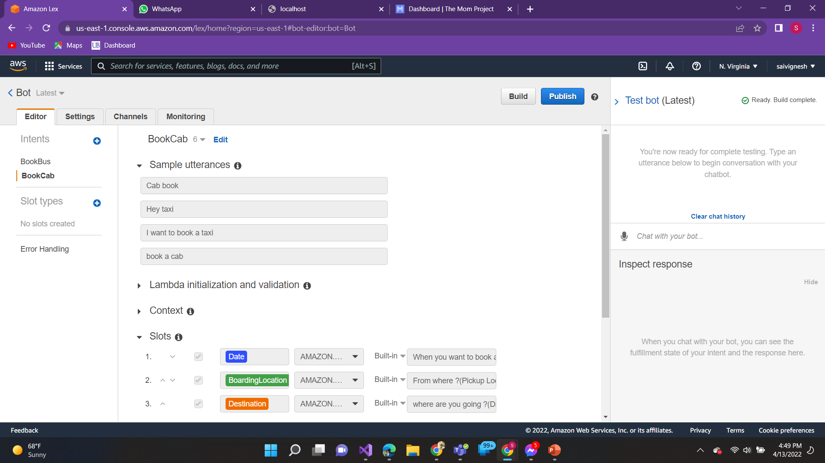
Creating sample utterances:

Slide 10
Creating Slots

Slide 11
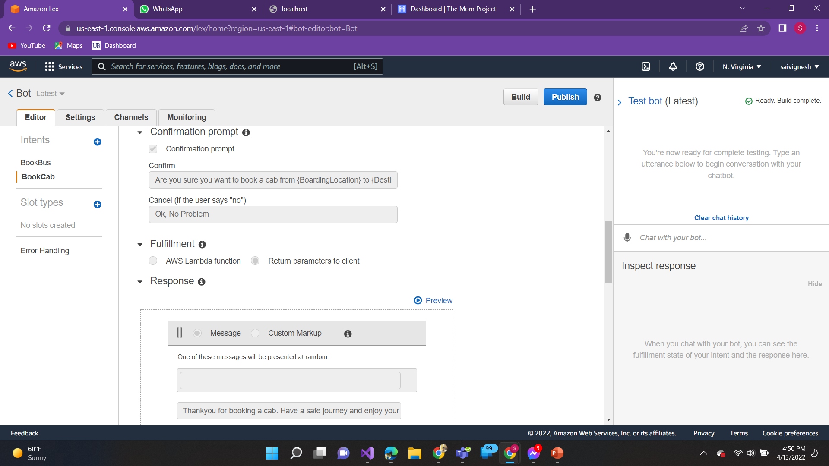
Creating Confirmation Prompt & Response

Slide 12
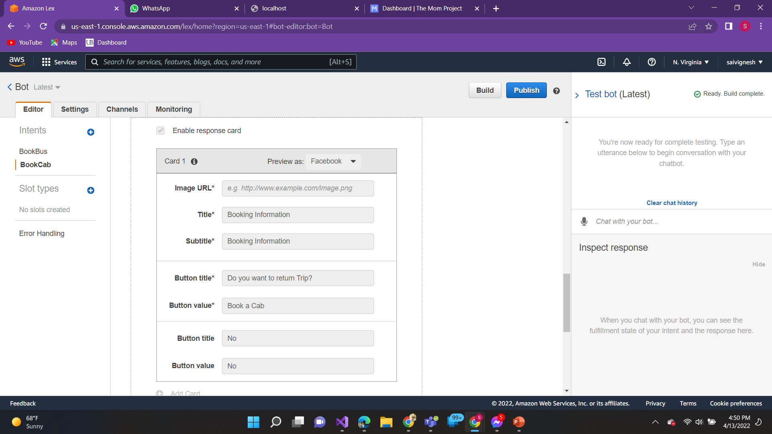
Enable Response Card:

Slide 13
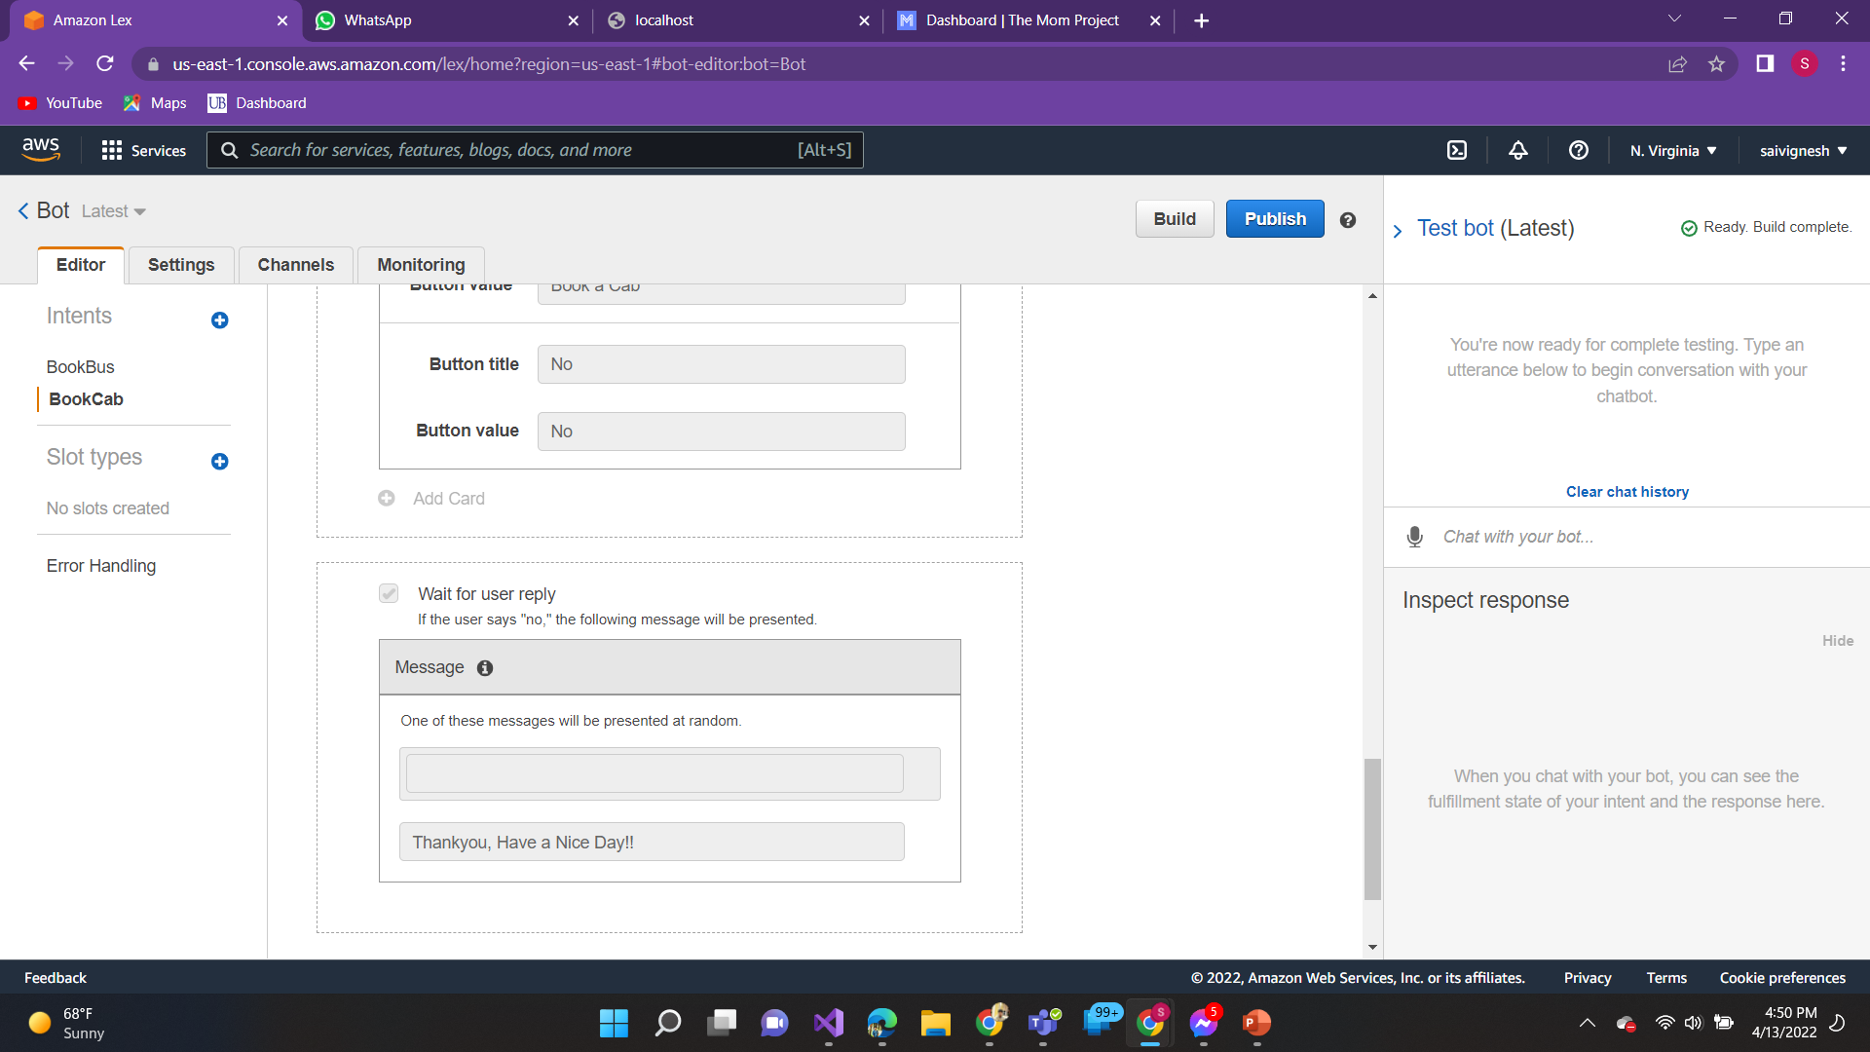
Reply, If user says “No”

Slide 14
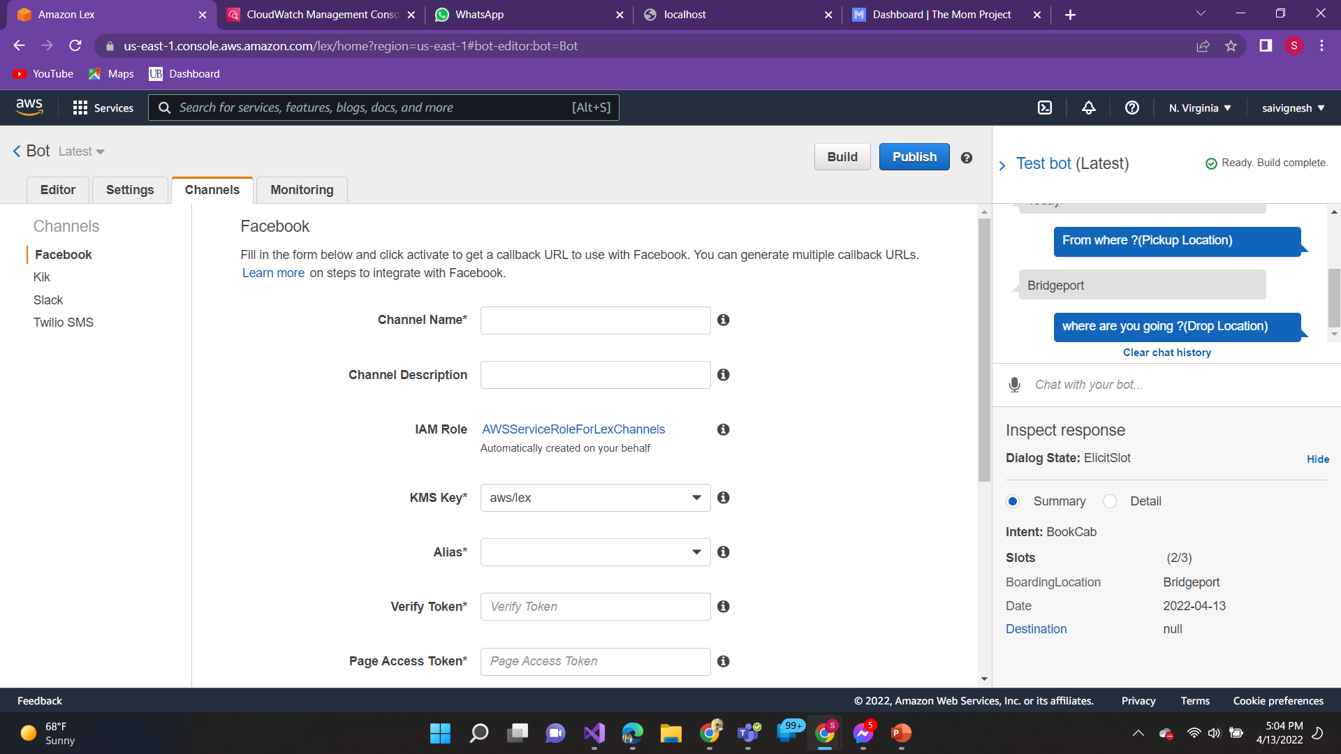
Creating a channels to connect Facebook Messenger:

Slide 15
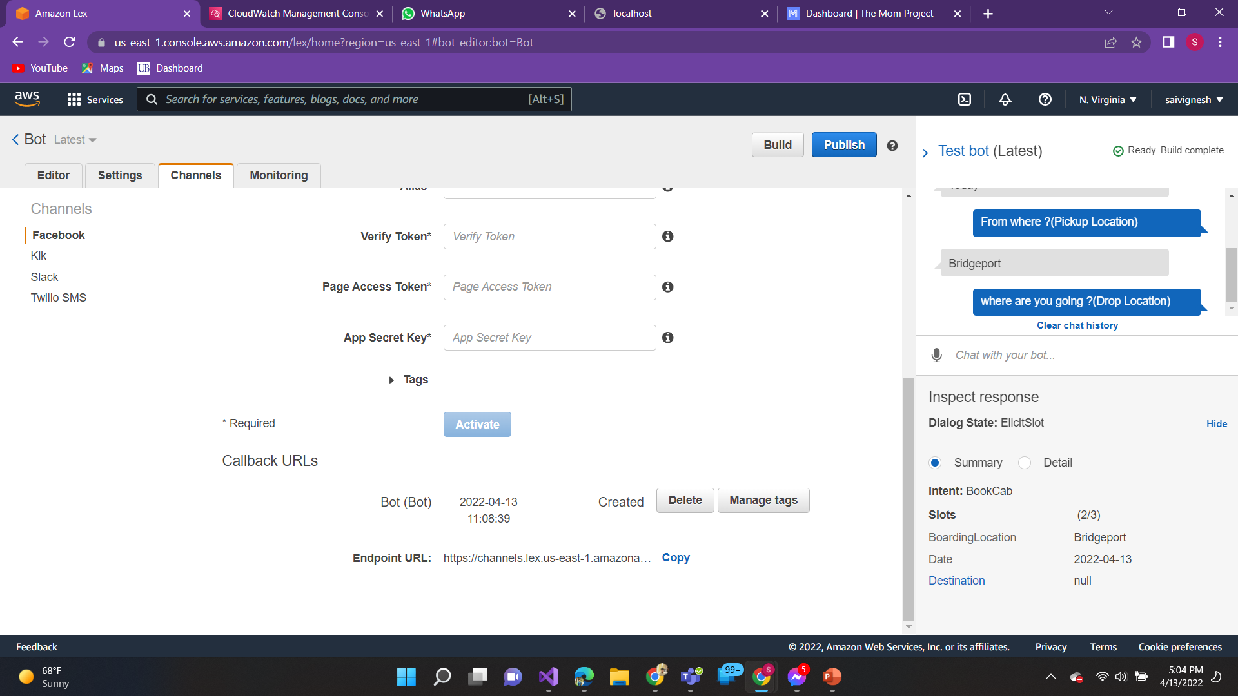
Facebook chatbot - Endpoint URL

Slide 16
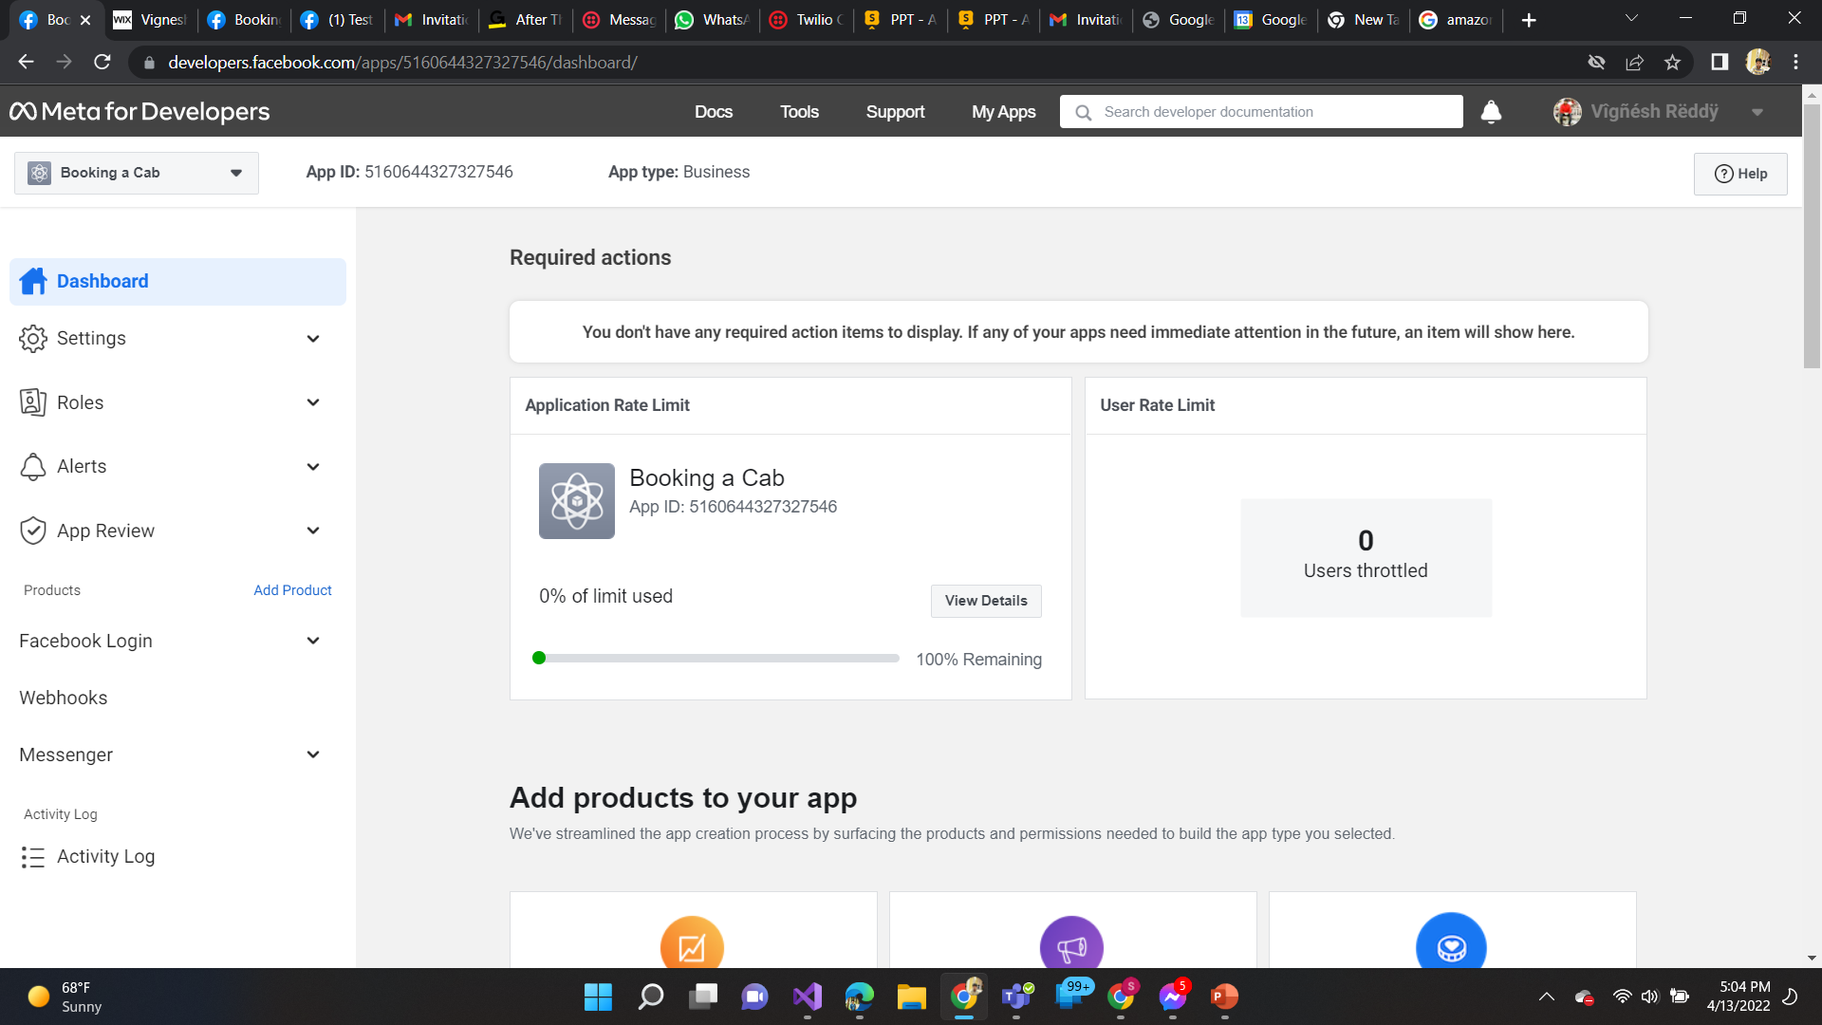
Creating a facebook messenger api for chatbot

Slide 17
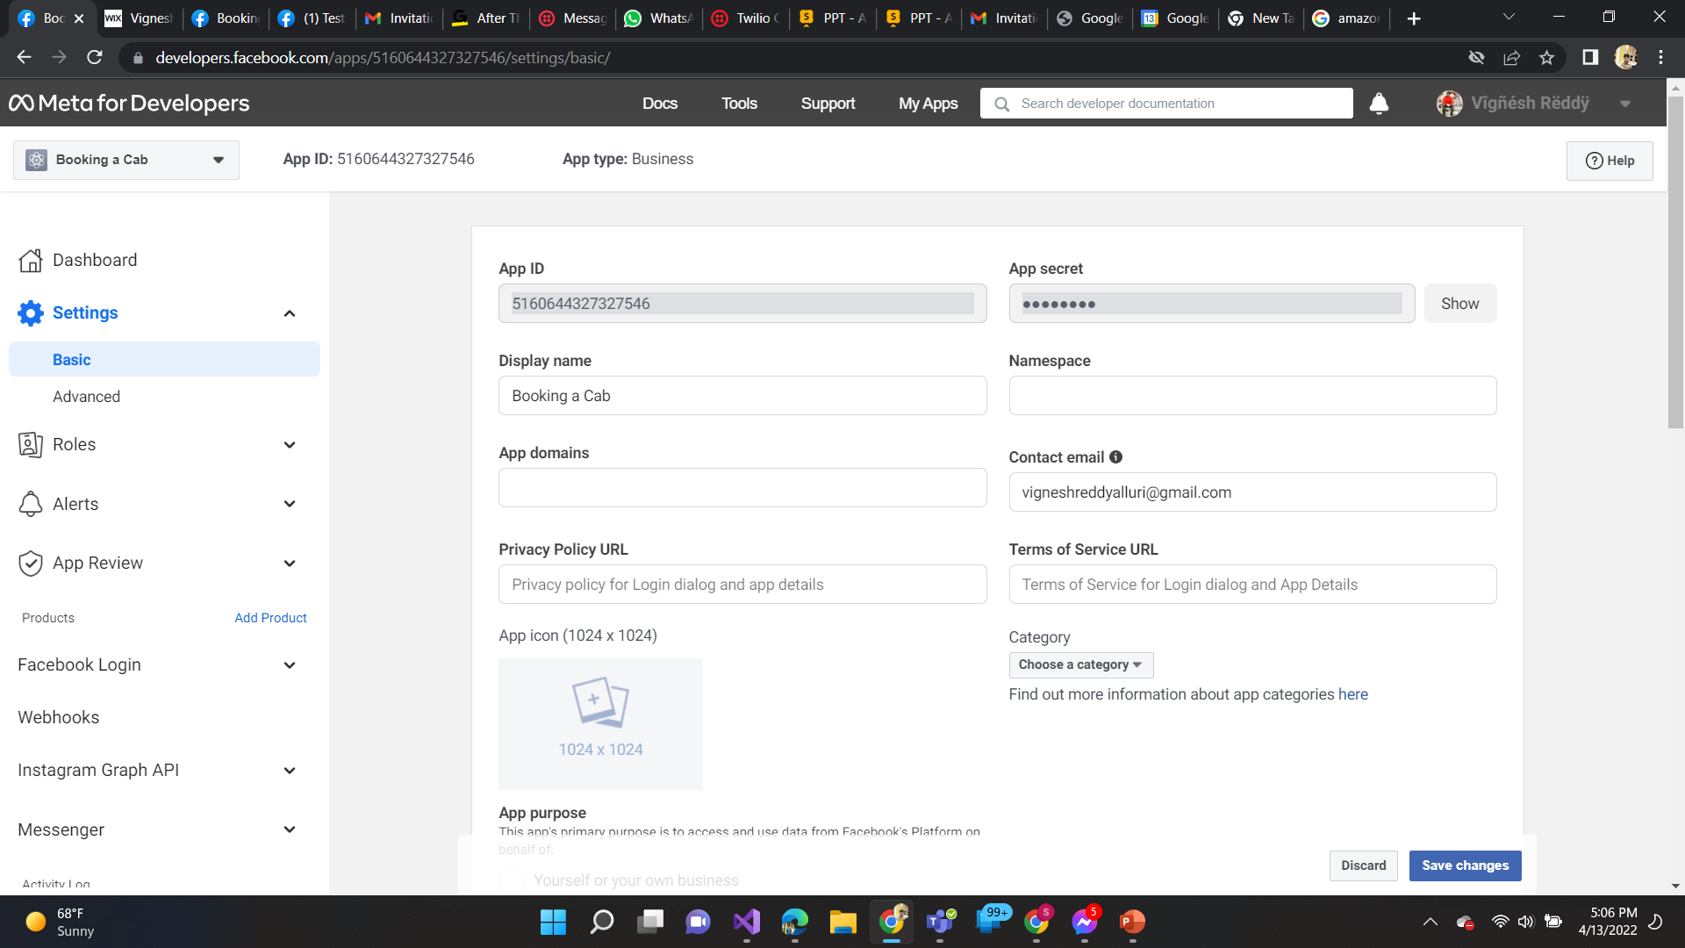

Slide 18
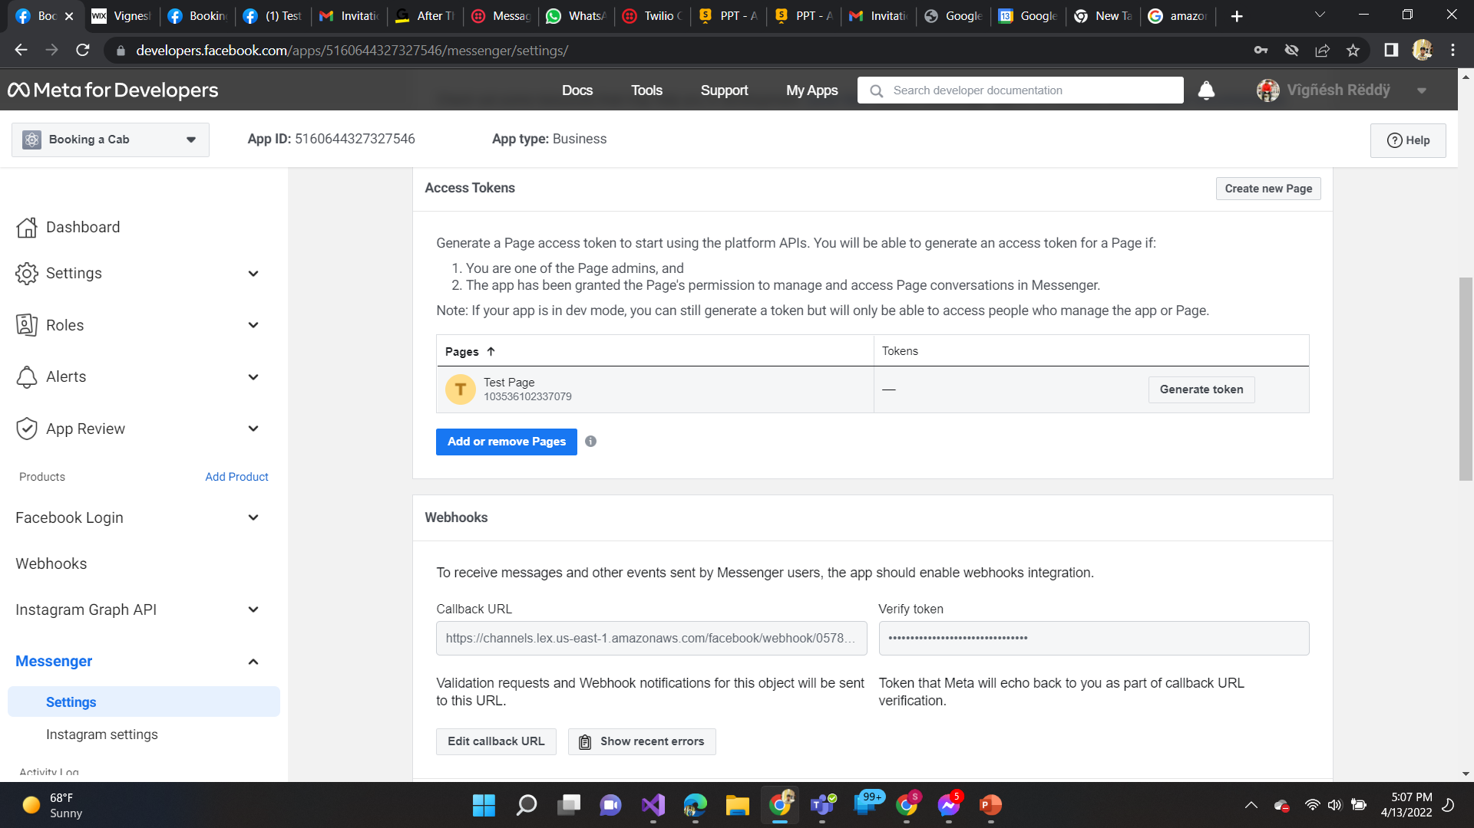

Slide 19
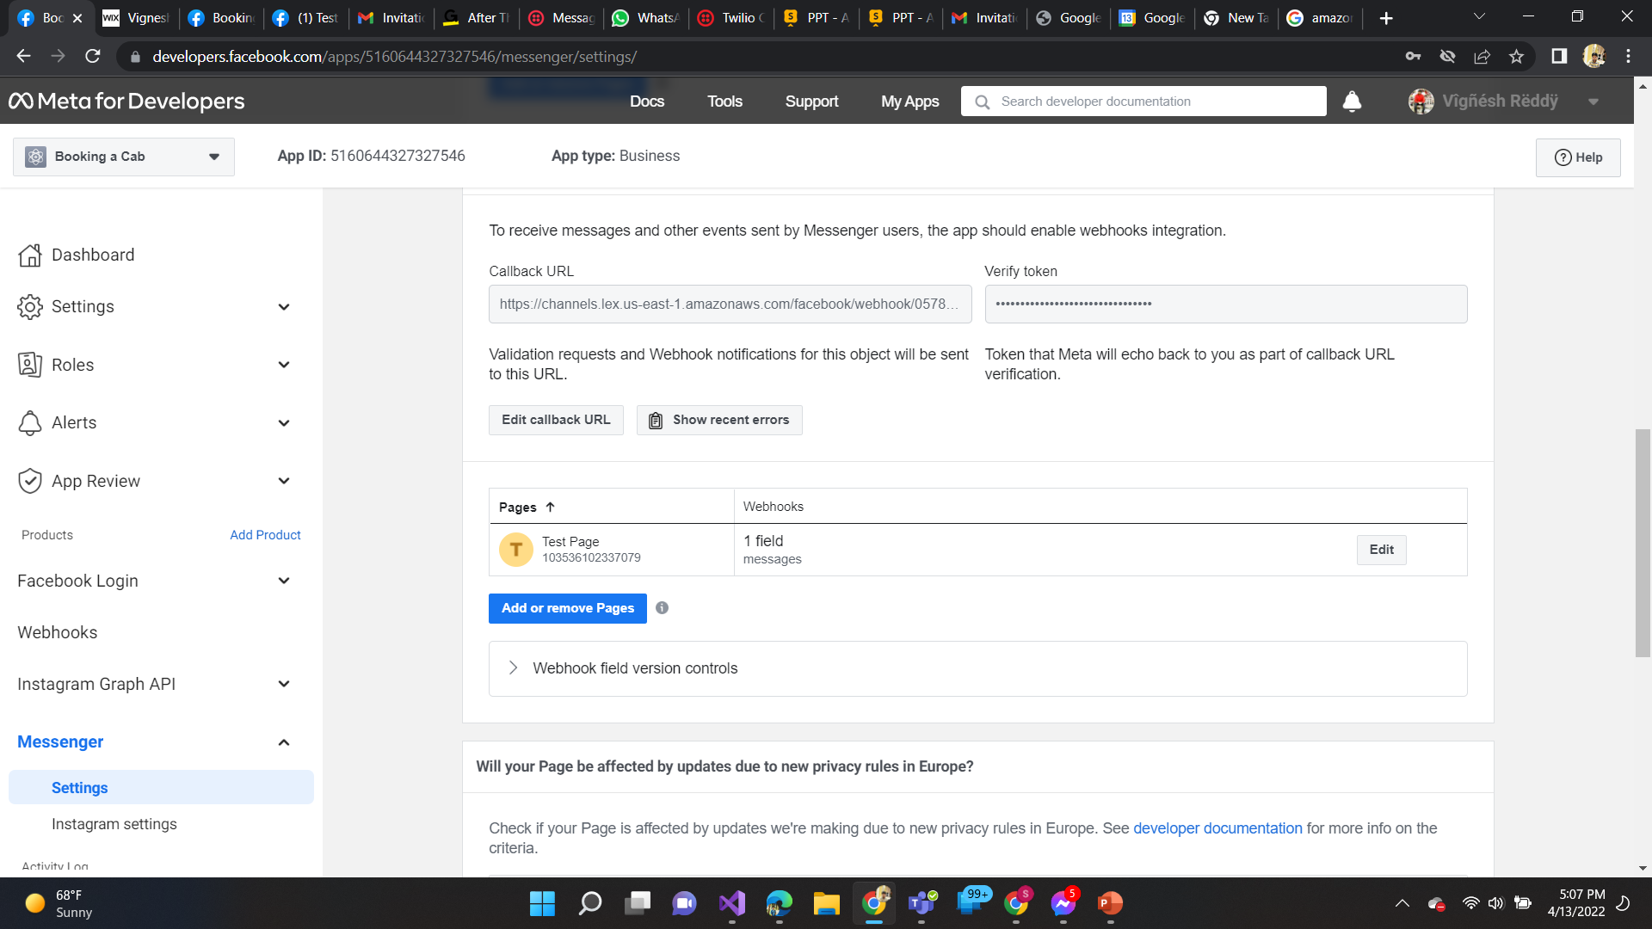

Slide 20
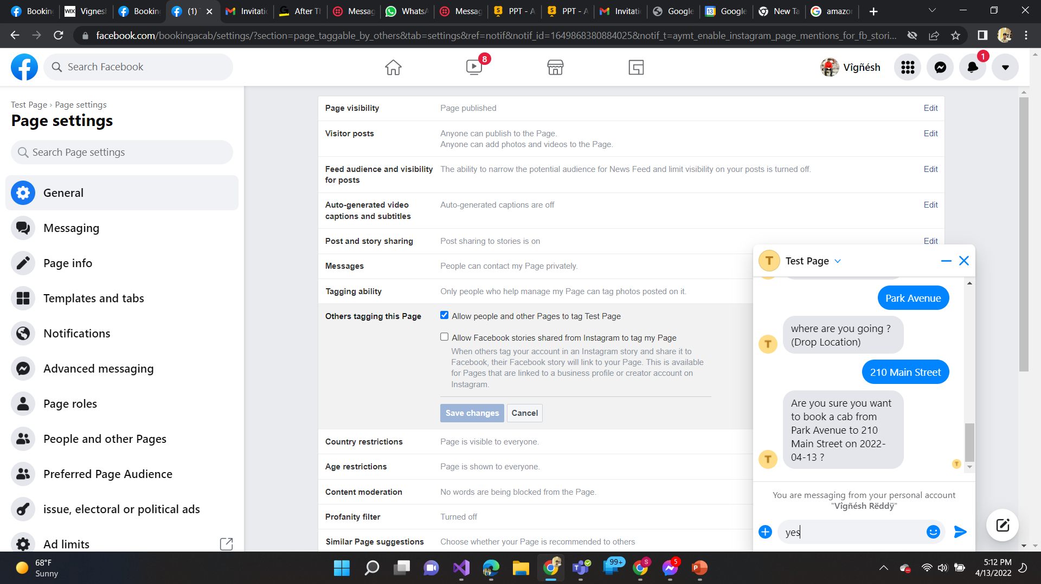
Facebook Chatbot:

Slide 21
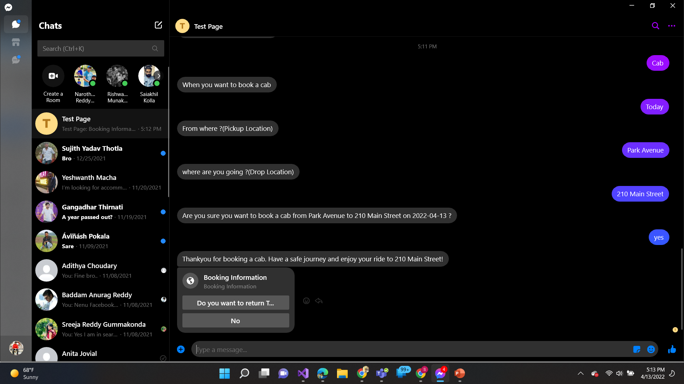
Messenger ChatBot

Slide 22
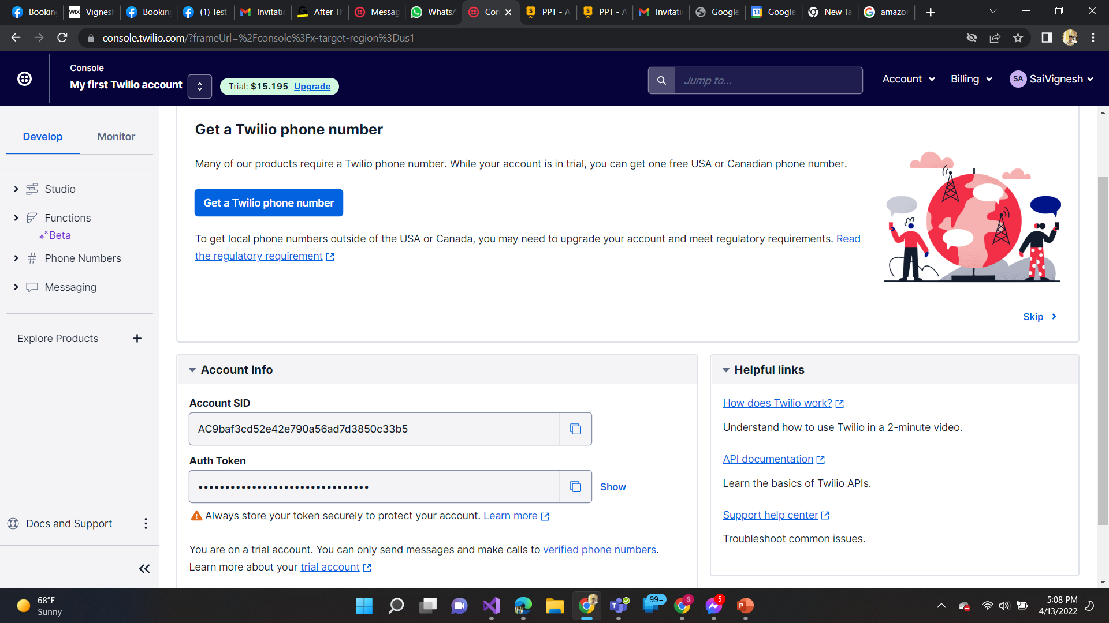
Creating a WhatsApp bot using Twilio

Slide 23

Creating a Channel from Lex to Twilio

Slide 24
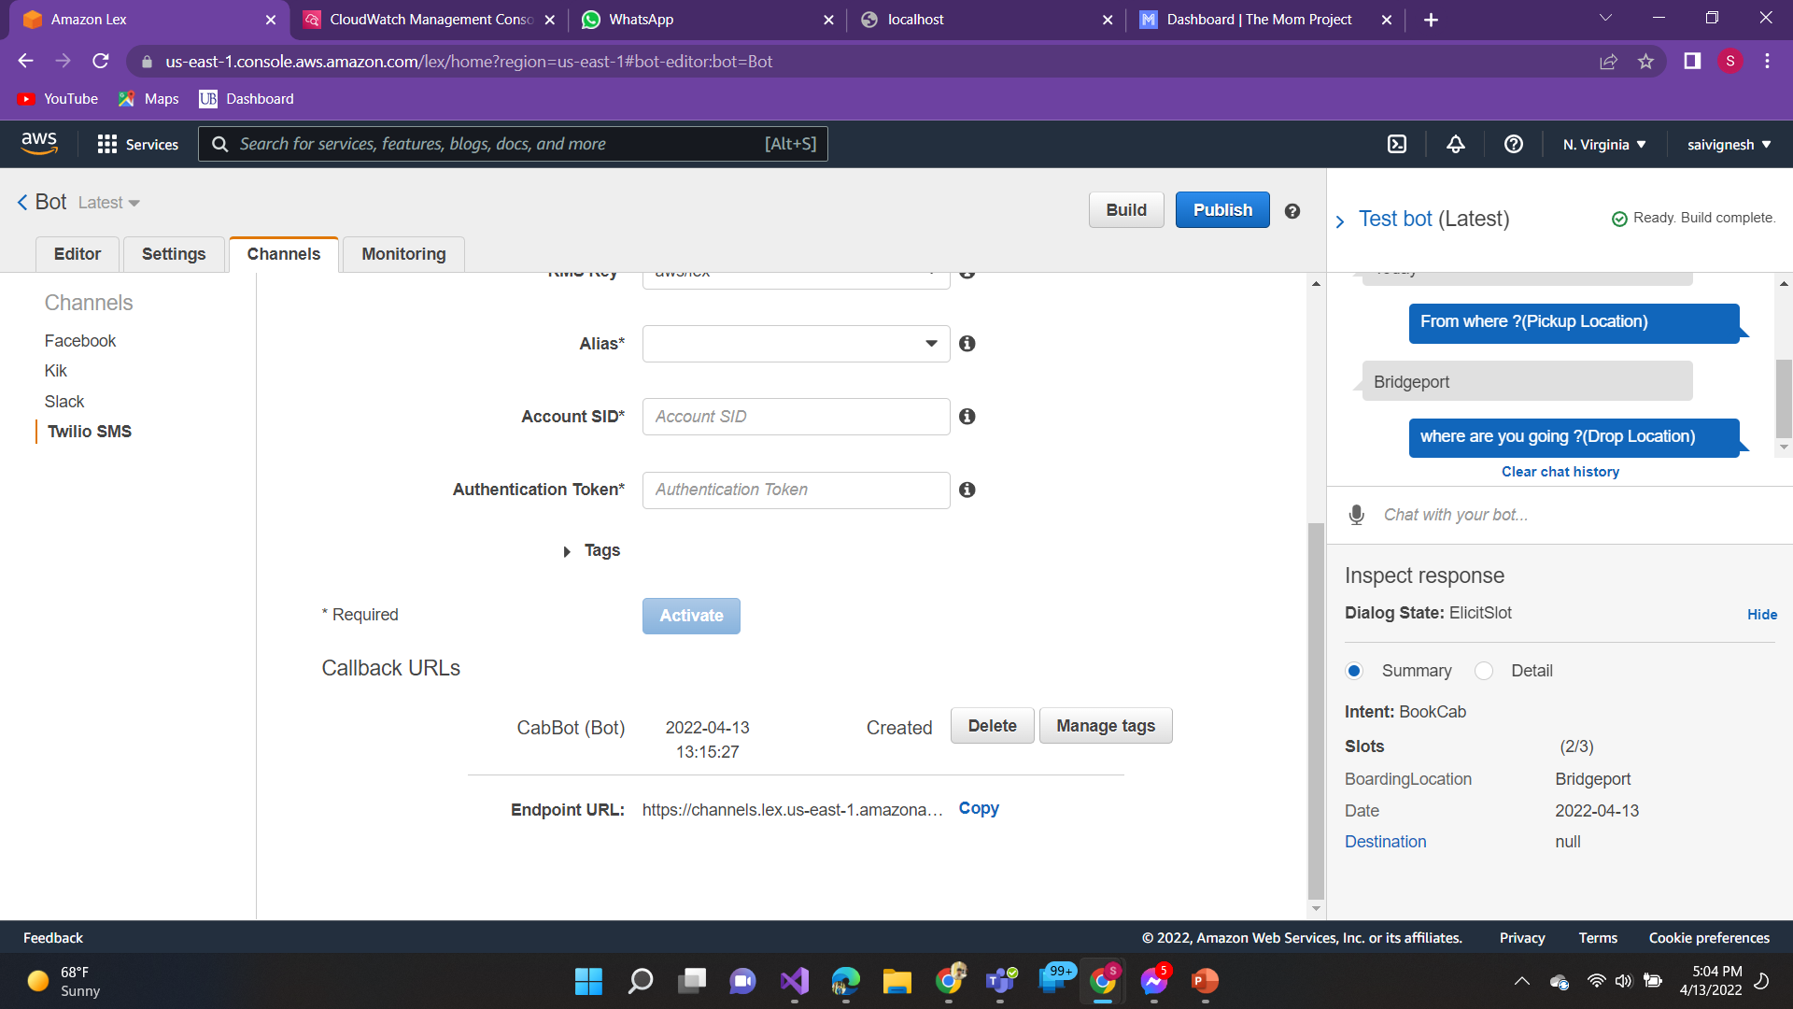
Generating Twilio Endpoint URL

Slide 25
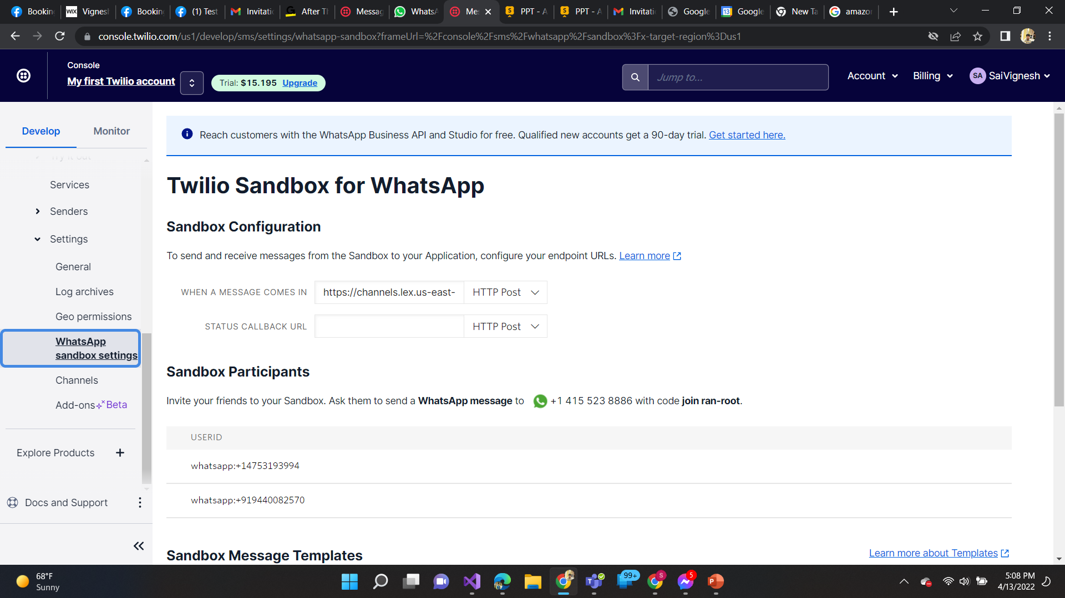
Sandbox Configuration to send messages by chatbot in whatsapp:

Slide 26
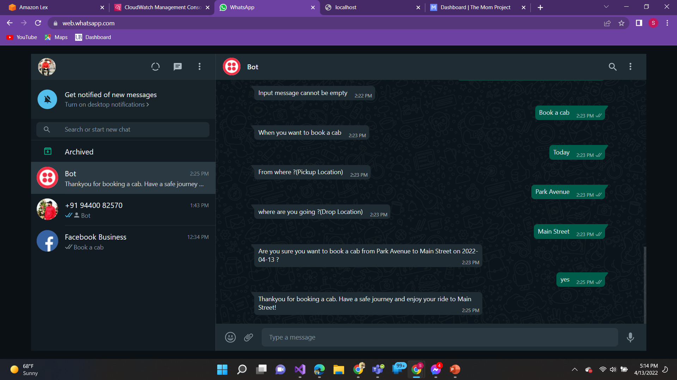
WhatsApp Bot

Slide 27


Thank You
Sai Vignesh Kumar Reddy Alluri - 1136665

